Slide 1














Users and Groups
Version 6.X
© ThoughtSpot Inc 2019
Notes:
Today we will cover:
Security
How users and groups are created
How we grant permissions to users (on the group level)

Slide 2
What?

Slide 3










What?
Users
Logical representation of a real user
within the ThoughtSpot environment.
Groups
Logical representation of a
group of users within
the ThoughtSpot environment.

Slide 4
Why?
Notes:
Why do we have users and groups?

Slide 5
Why?
Users
All data needs to be associated with an entity
so that every time a user logs in they only see THEIR data.
Groups
Groups determine sharing, data access, row level security,
and permissions.

Slide 6
Usage Based Ranking (UBR)
User
UBR uses past searches to determine:
Priority of search suggestions
Relative importance of columns & data for SpotIQ
Interpretation by SearchIQ
Answer Explorer suggestions on Pinboards
These apply hierarchically.
Group
Everybody

Slide 7
How?

Slide 8
Two type of users & groups
1
Locally Managed
Created and managed within
ThoughtSpot manually or via API

Slide 9
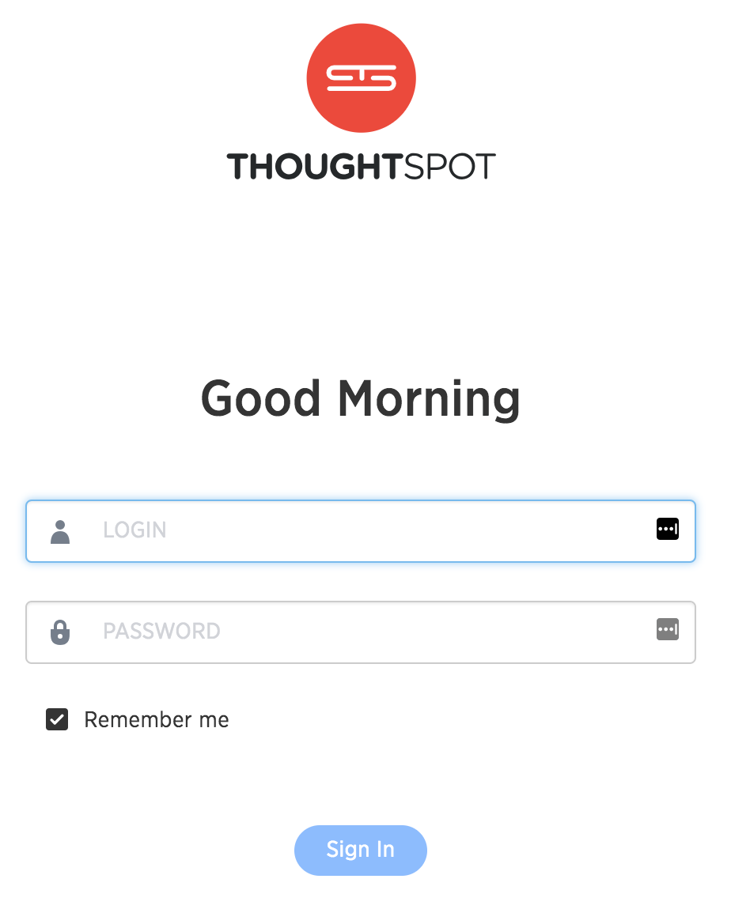
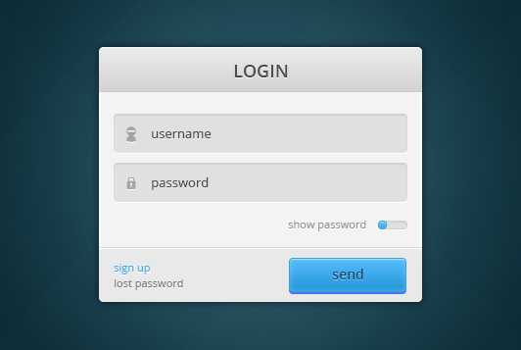
Two type of users & groups
1
Locally Managed
Created and managed within
ThoughtSpot manually or via API
Managed Externally
Users & groups are managed by
Active Directory, SAML, or
other external system.
2

Slide 10
Local Users/Groups
Notes:
Now we’ll focus on local users/groups.

Slide 11
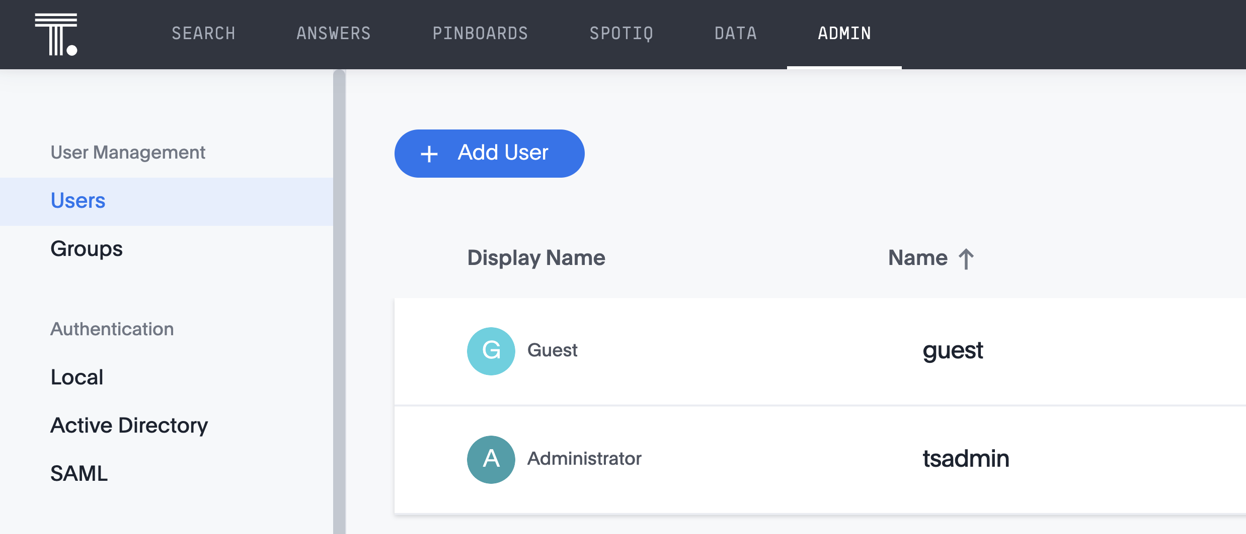
Local User
Local User
Notes:
If I’m logged in with someone with an Administrative privilege (tsadmin), then I see the additional menu item called Admin. If you click on it, it’ll put you in to User Management, click Add User. You can manually add a locally managed user.

Slide 12
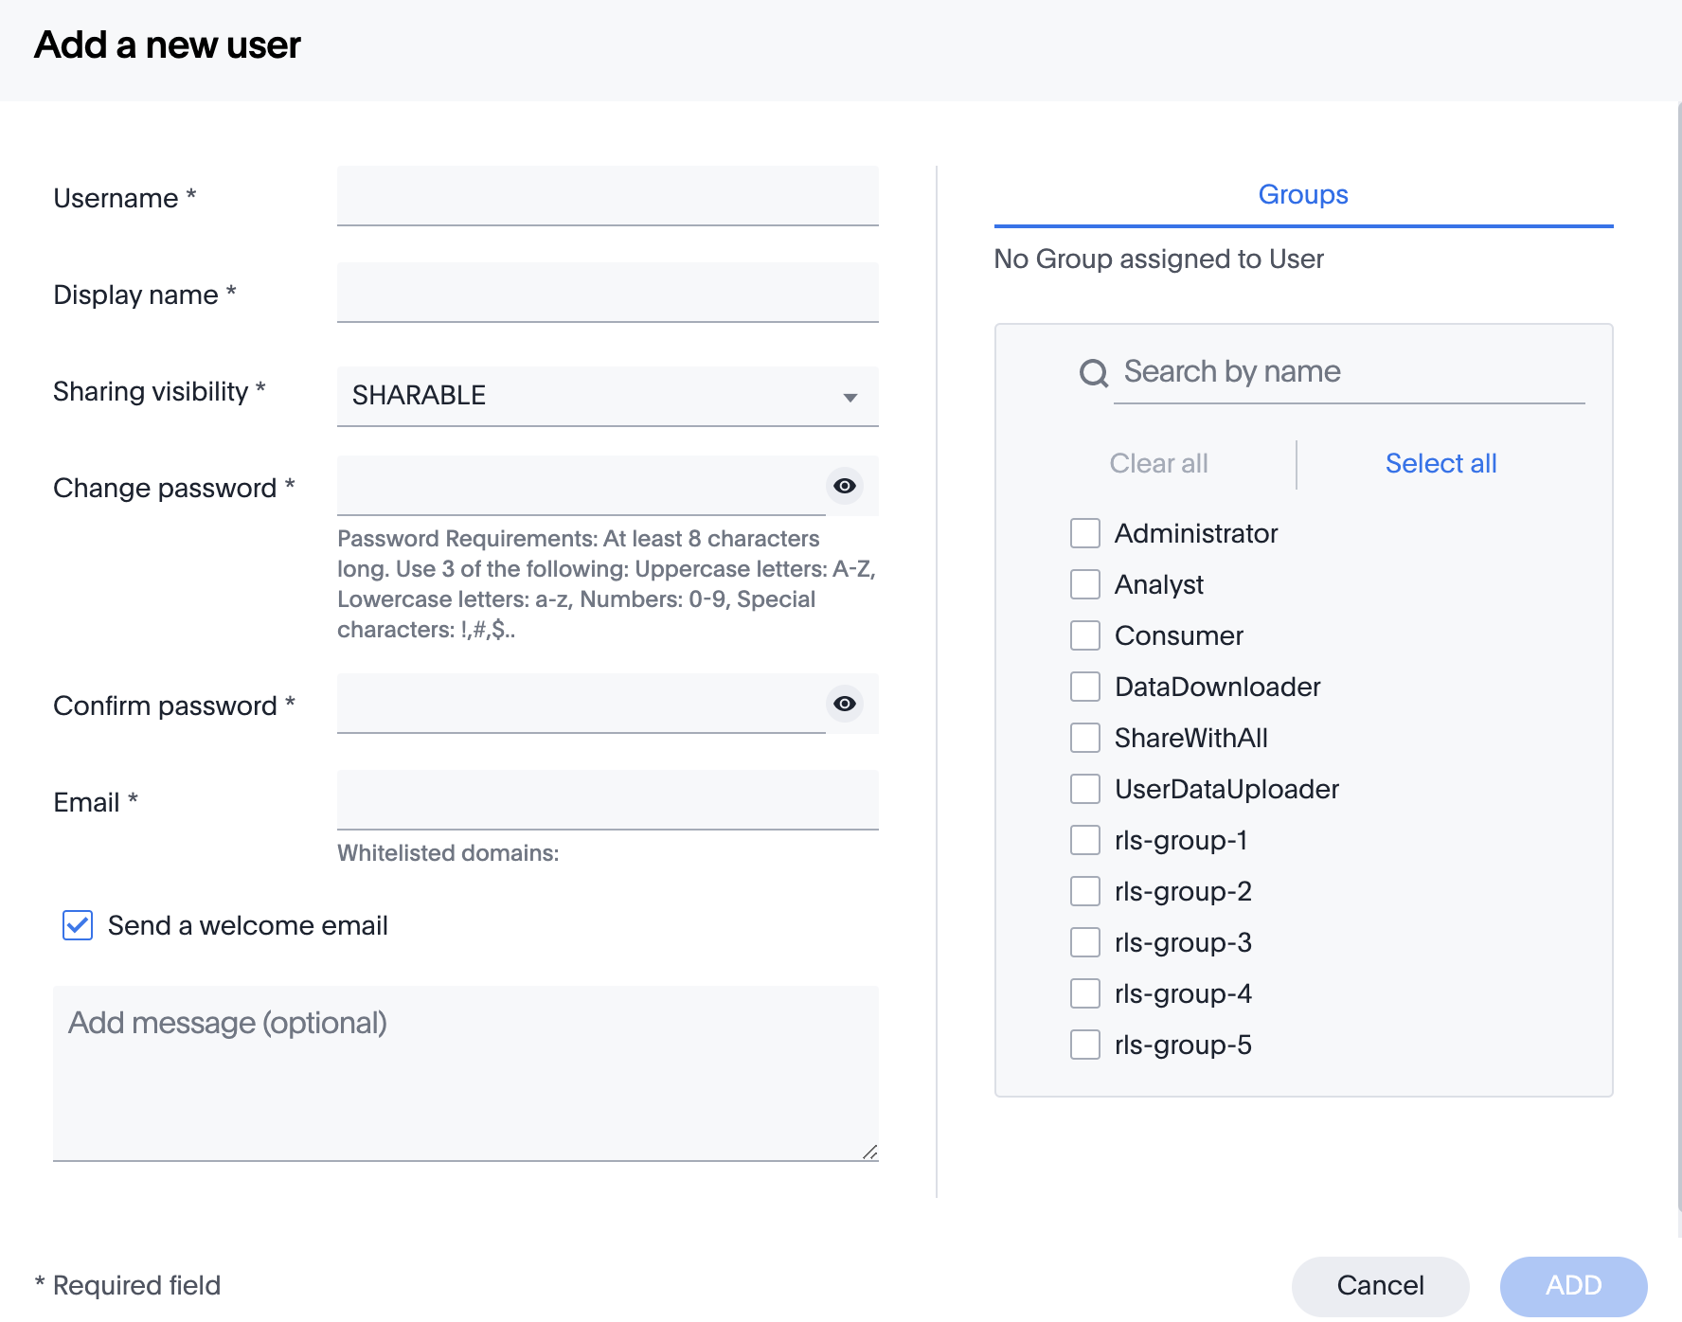
Local User
Create users and groups through the browser
“Sharable” means that the user is visible when sharing
Select the user’s group(s) from the list

Slide 13
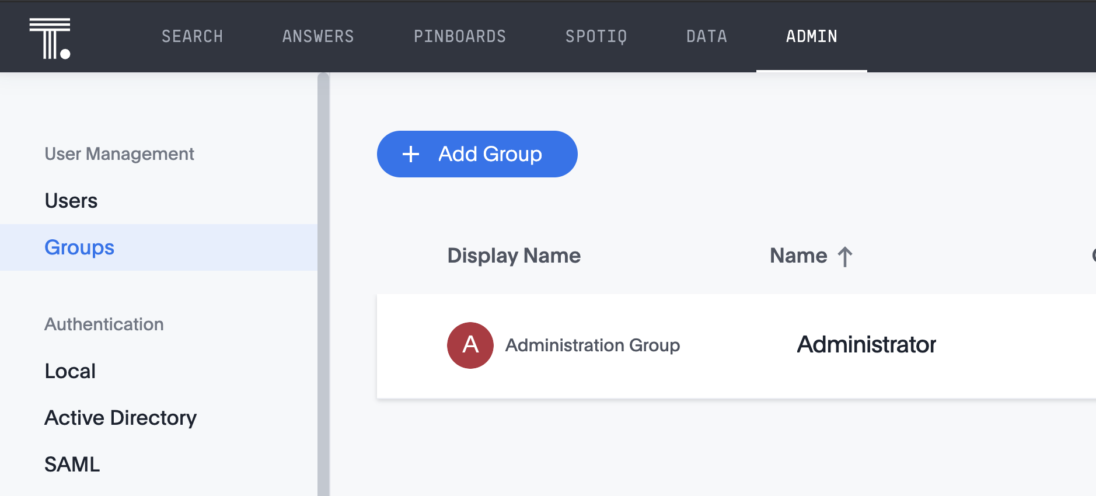
Local group
Local group

Slide 14
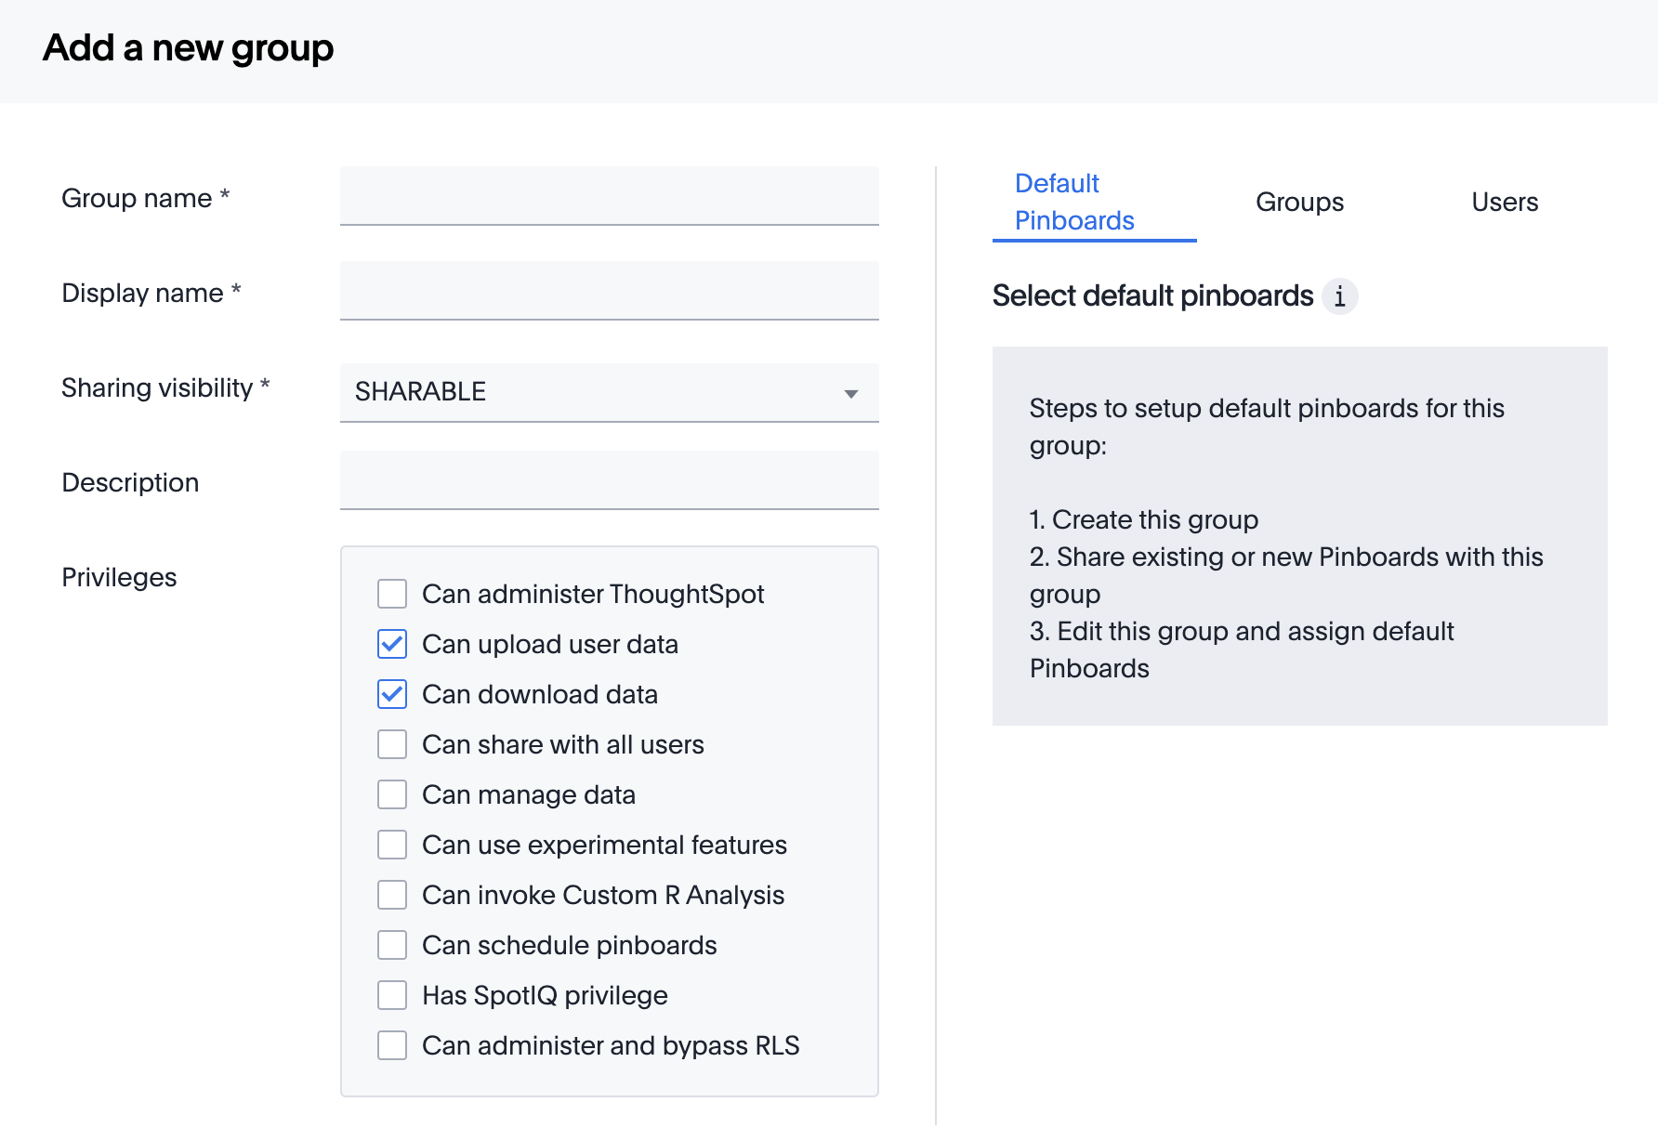
Add a new group
“Sharable” means that the group is visible when sharing
Select Default Pinboard for groups
Add other groups or users to new group

Slide 15
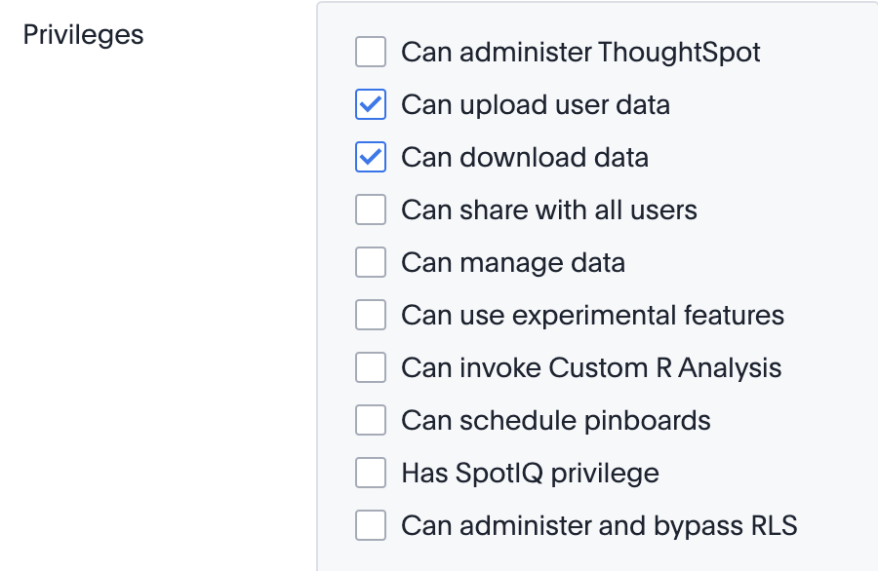
Privileges for Groups
Set at the group level
Support very specific use cases
Enable features per group
Notes:
Can Administer ThoughtSpot: Can manage Users and Groups and has view and edit access to all data. This makes all users in the group Administrators.
Can upload user data: Can upload their own data from the application's Data page.
Can share with all users: Can see the names of and share with users outside of the groups the user belongs to. Members of groups with this privilege can also share with groups marked as NOT SHARABLE.
Can manage data: Can create worksheets and views.
Can use experimental features: Can access trial and experimental features that ThoughtSpot makes available to early adopters.
Can invoice Custom R Analysis: Can access R scripts to further explore search answers.
Can schedule pinboards: Can create pinboard schedules and edit their own scheduled jobs.
Has SpotIQ privilege: Can use SpotIQ.
Can administer and bypass RLS: Can add, edit, delete existing RLS rules. RLS rules do not apply to this group. This group has access to check or uncheck the Bypass RLS on a worksheet checkbox.

Slide 16
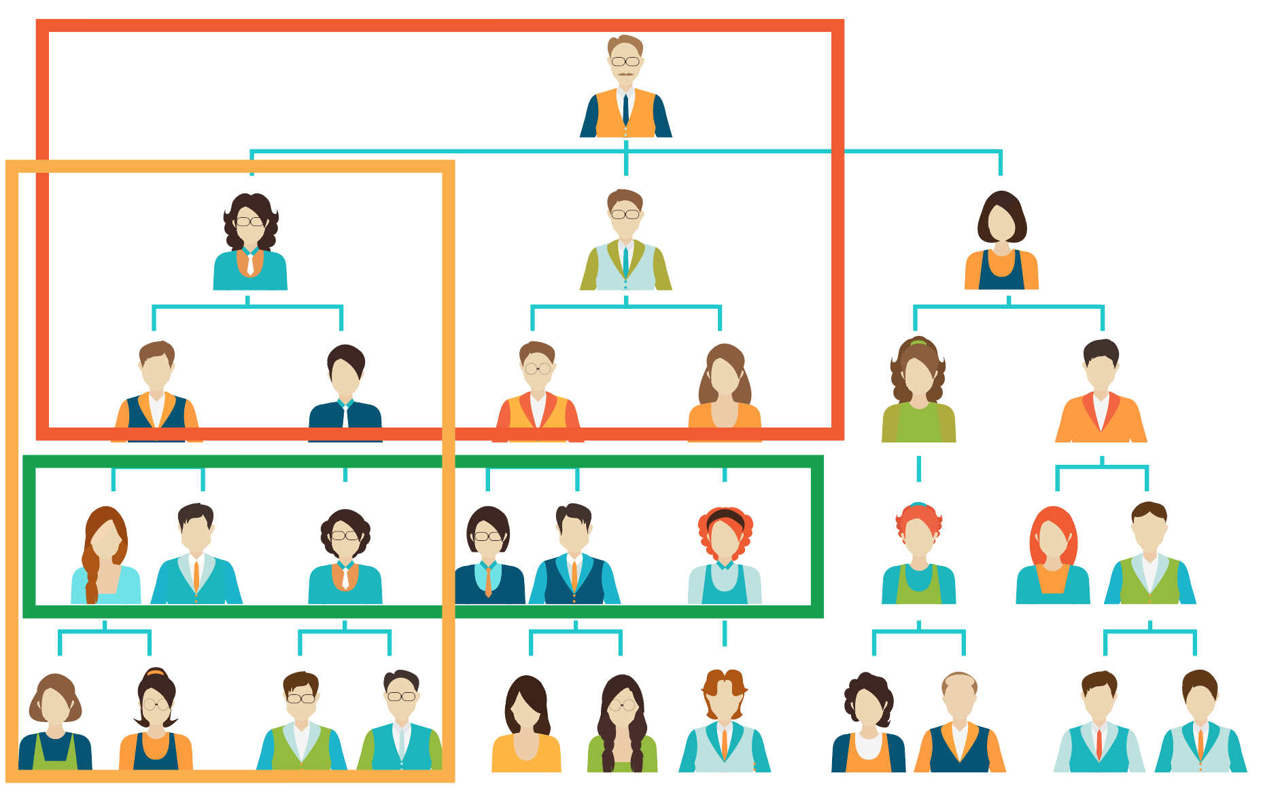
Membership and Permission Management
User
Can be part of one or more groups. No permissions by themselves.
Group
Can be part of one or more groups. No group level login. Privileges assigned at Group level.

Slide 17
Externally Managed Users/Groups: LDAP
Notes:
More commonly, users and groups are managed externally.

Slide 18
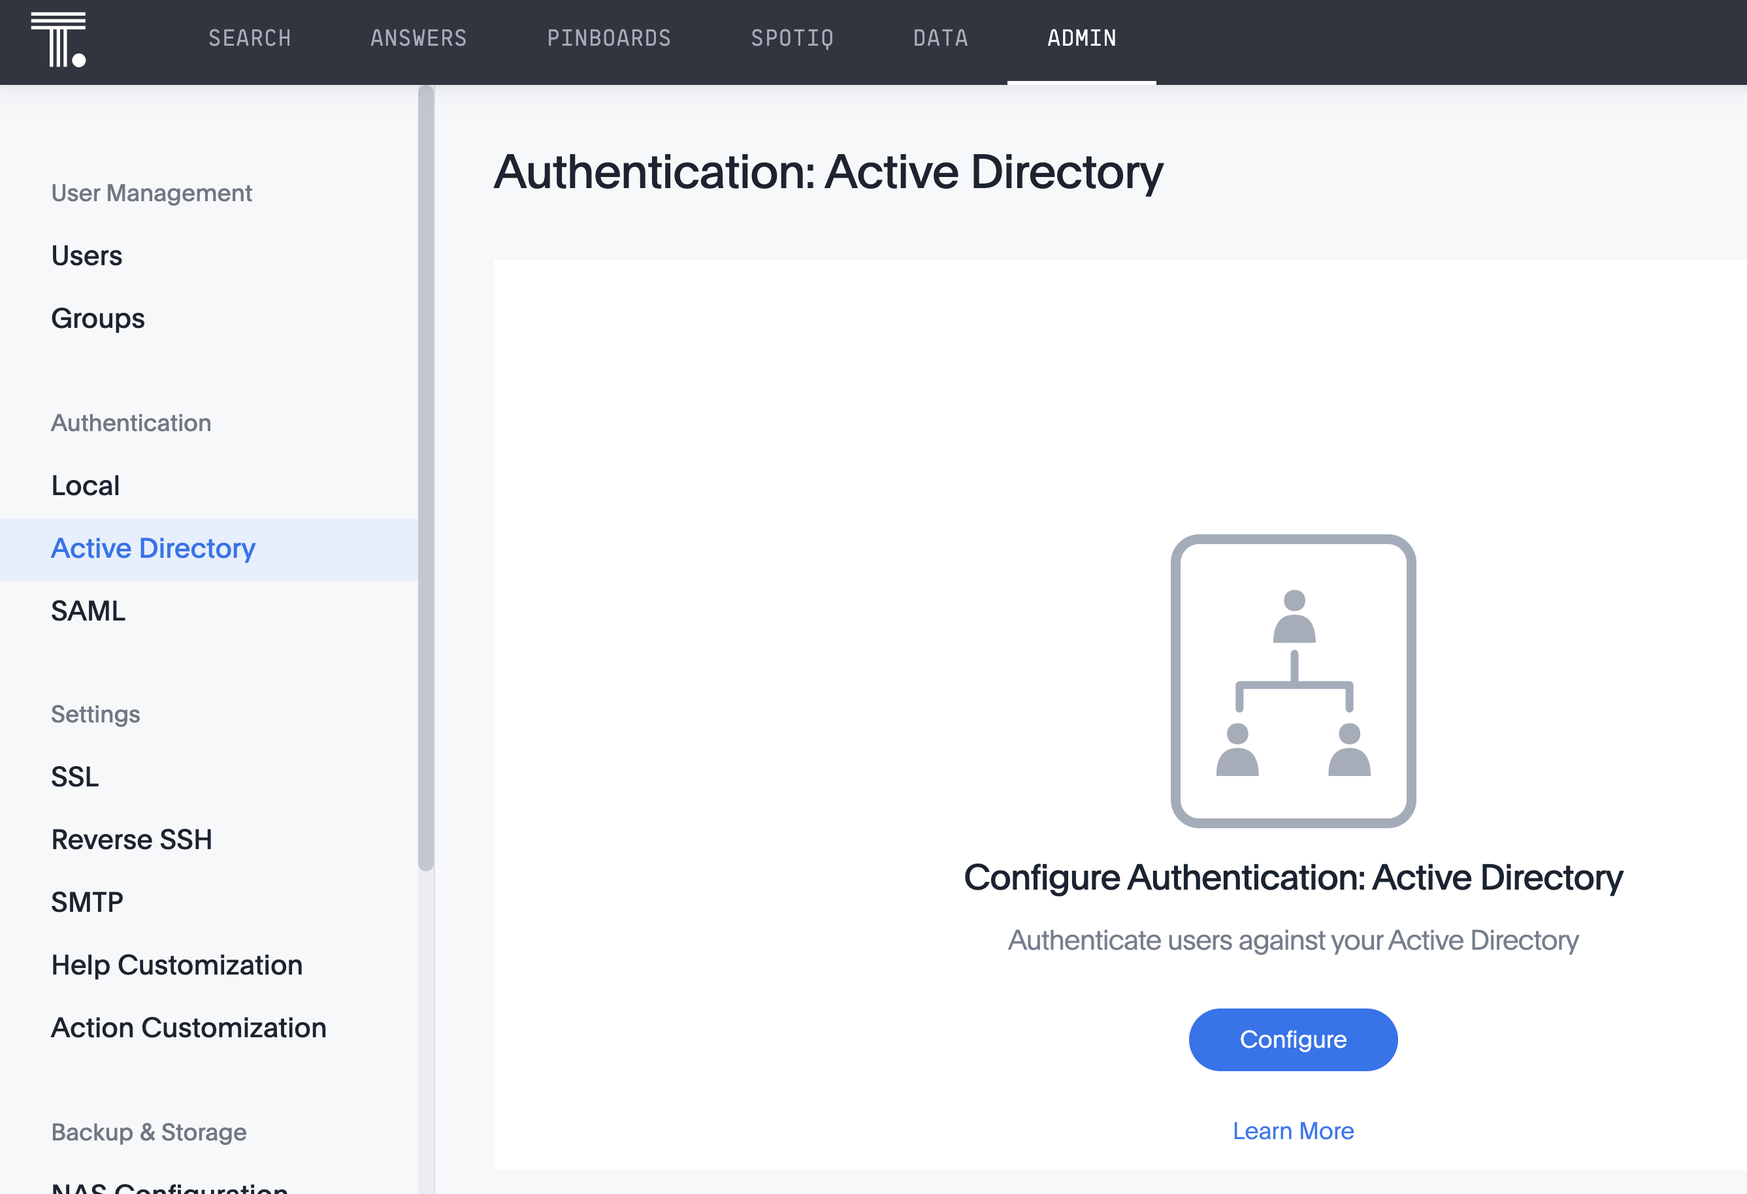
Configuring LDAP via Admin Portal

Slide 19
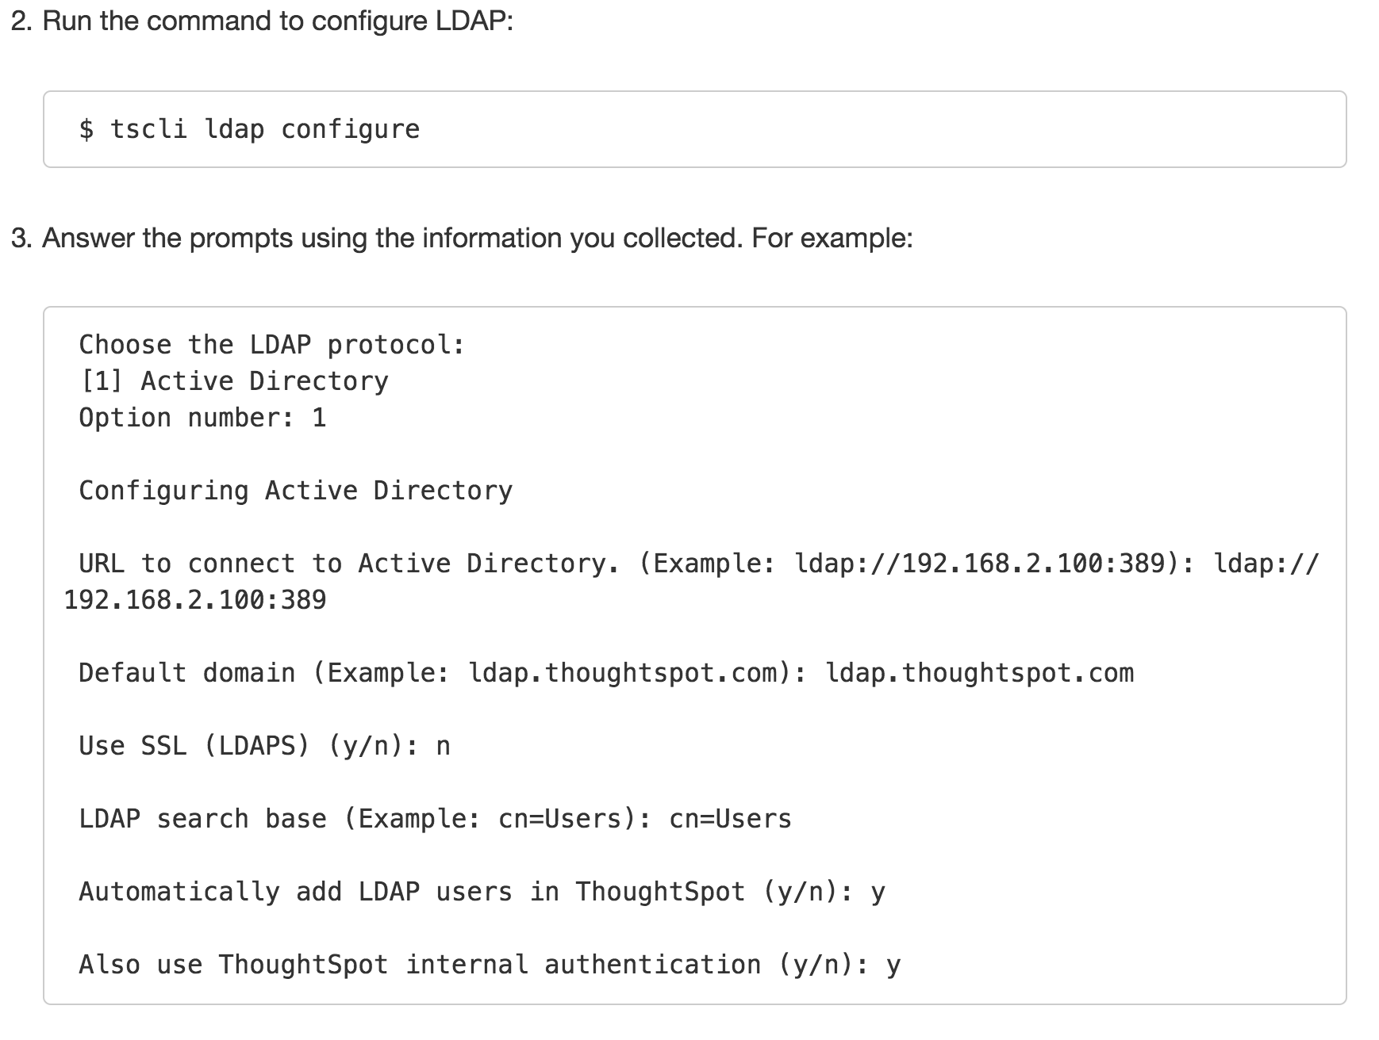
LDAP Users and Groups
tscli ldap configure
ActiveDirectory
No OpenLDAP support

Slide 20
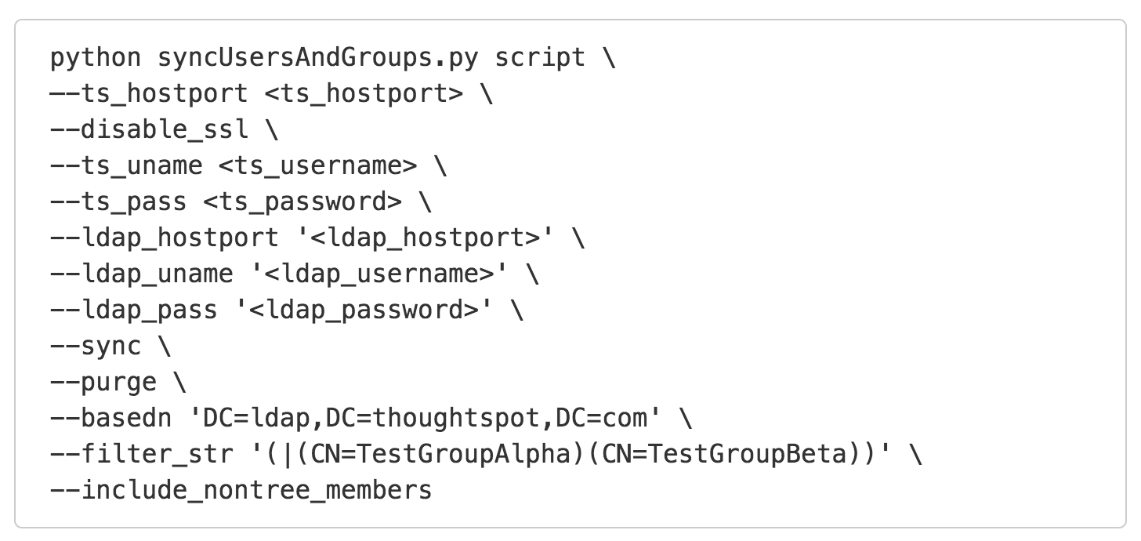
LDAP Users and Groups sync script

Slide 21
Externally Managed Users: SAML
Notes:
How we manage SSO when you have users not part of an organization.

Slide 22




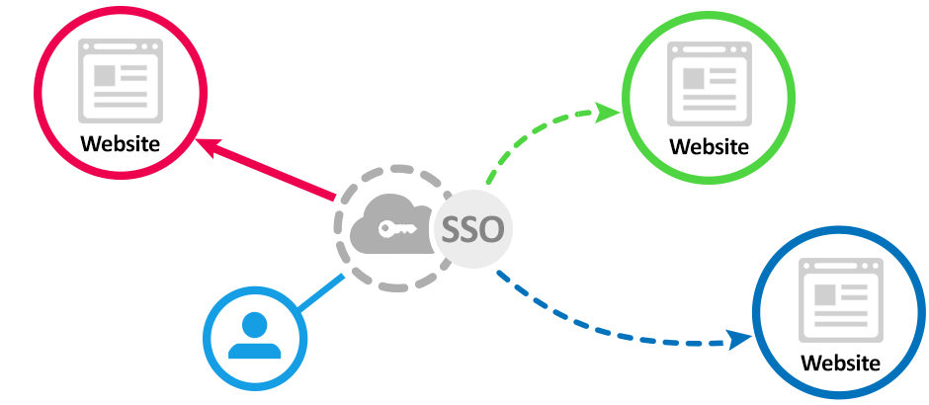
SAML Users (Single Sign On)
SAML = Security Assertion
Markup Language
Can be used for SSO (single sign-on)
with ThoughtSpot
Often used for OEM/Embedded
use cases

Slide 23
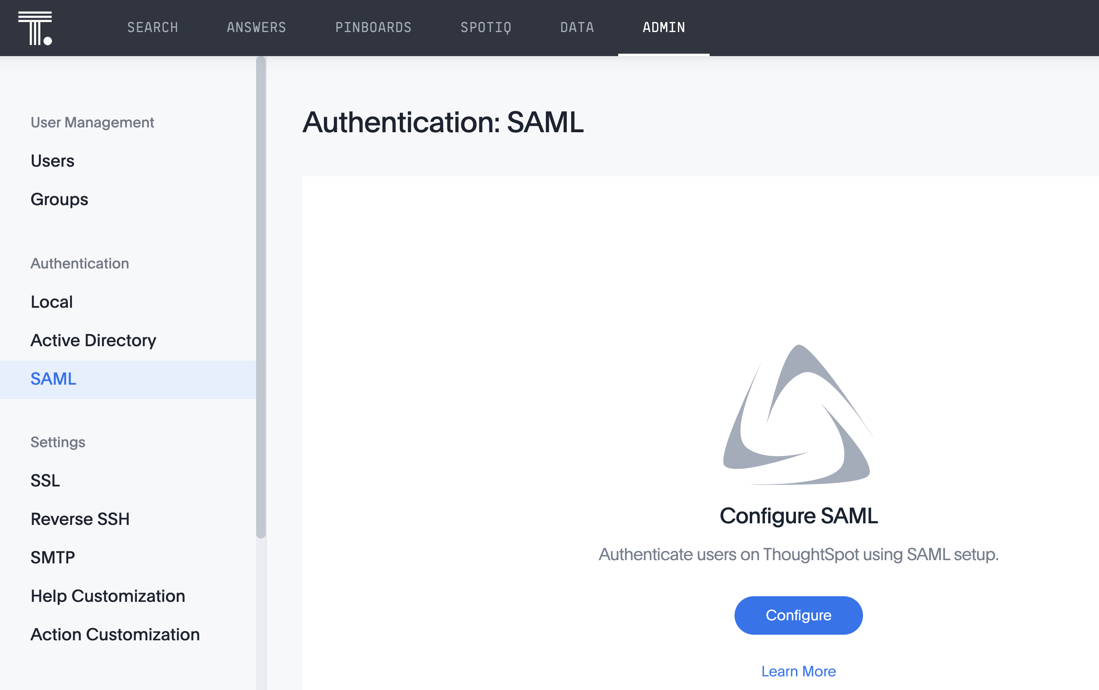
SAML Users (Single Sign On)

Slide 24
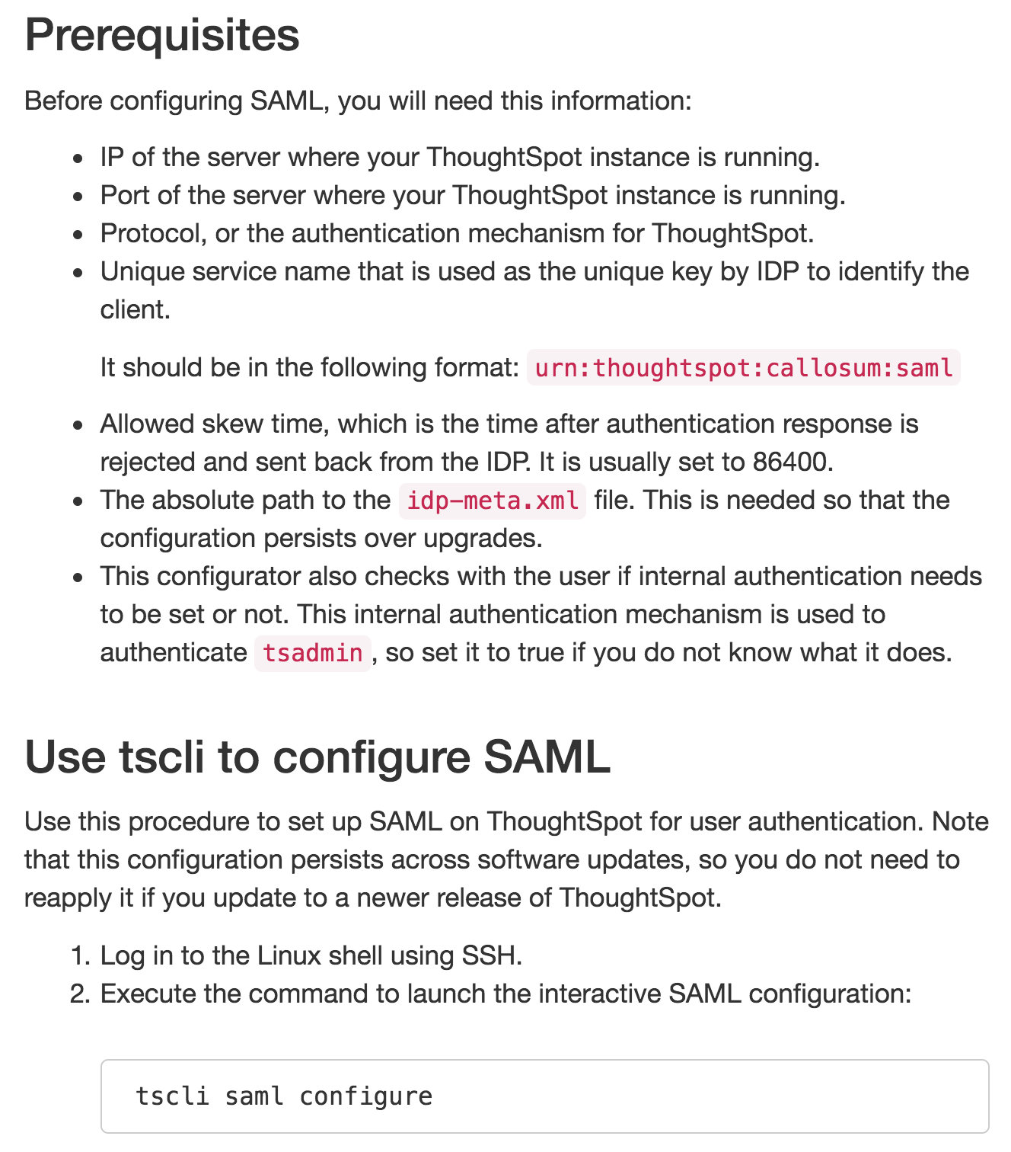
SAML Users (Single Sign On)
SAML = Security Access
Markup Language
e.g. CA SiteMinder, Okta
SAML requires an IDP (Identity Provider),
such as Active Directory
tscli saml configure

Slide 25
Externally Managed Users/Groups: Notes

Slide 26
Important things to know
ThoughtSpot can only talk to either A:D (LDAP) or SAML end point.
A corporate client will have one or both. Choose SAML to support future portal use cases.
We love Okta, OneLogin, SiteMinder, Centrify and other IDPs we’ve used with clients.
Anything extra (2-factor auth, RSA tokens, etc.) are up to the client to bundle with their IDP.

Slide 27
Introducing Admin Portal
Notes:
Those are the 2 main methods- 99% fall in those.

Slide 28
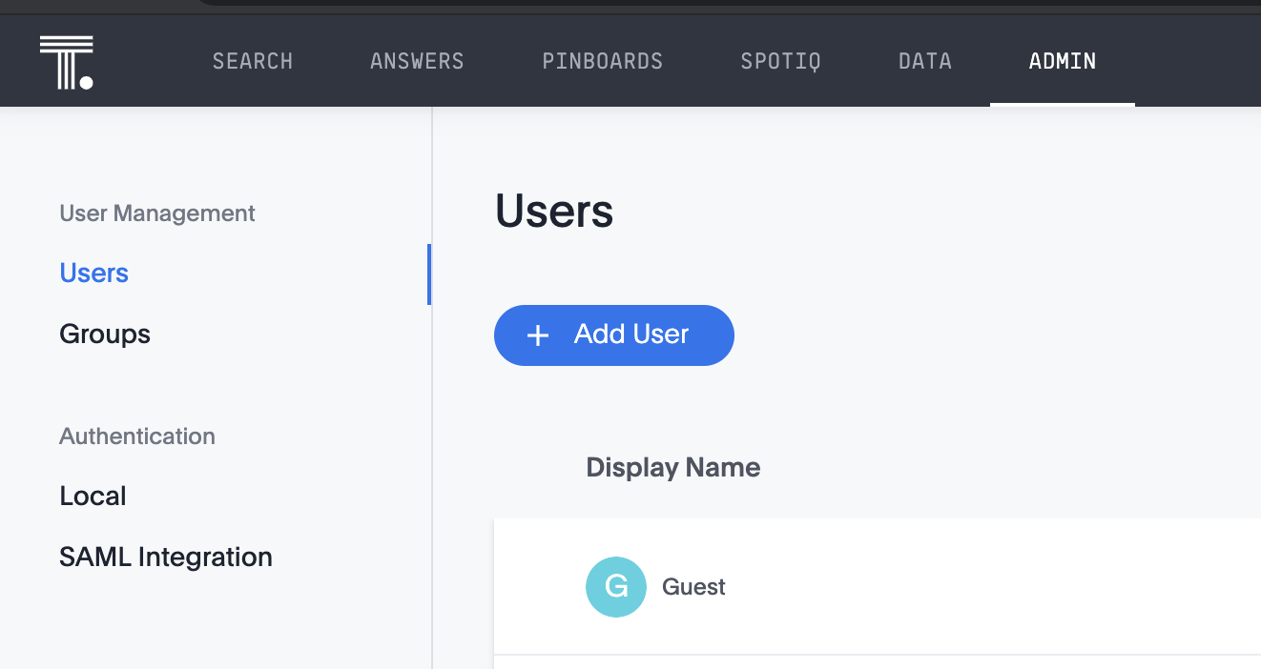
Admin Portal (available in TS Cloud)
Administrators can manage and authenticate both users and groups in the Admin Portal.

Slide 29
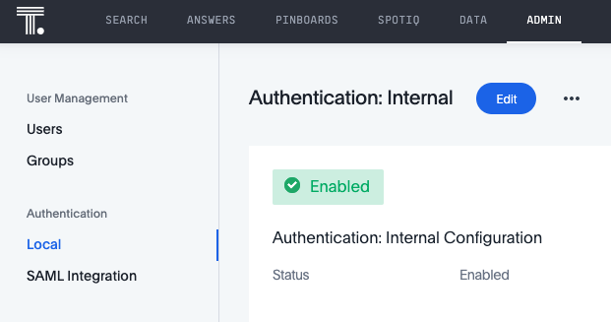
Internal Authentication via Admin Portal
If organizations don’t use LDAP or active directory, or users are created only in ThoughtSpot, you can authenticate users against ThoughtSpot internal authentication.
Notes:
If you disable local authentication, no local user can log into ThoughtSpot. Passwords are not saved in ThoughtSpot, they are run through a one-way hashing algorithm and stored in Atlas.

Slide 30
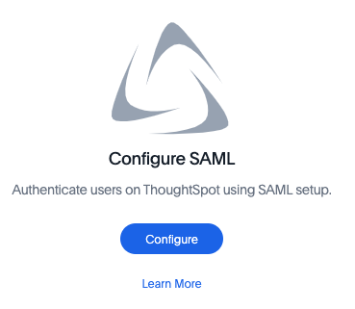
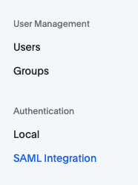
SAML Authentication via Admin Portal
You can set up SAML through the shell on ThoughtSpot using a tscli-based configurator or through Admin Portal user interface.

Slide 31
Other authentication methods
Notes:
Those are the 2 main methods- 99% fall in those.

Slide 32
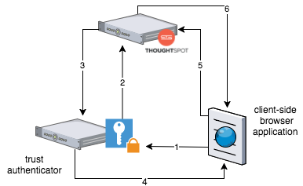

Token based authentication
Used in Embedded Scenarios
tscli tokenauthentication enable
For more on token-based authentication:
https://scotch.io/tutorials/the-ins-and-outs-of-token-based-authentication

Slide 33
Public APIs
Notes:
Some of these enable you to do things that have an impact on users and groups.

Slide 34
Public APIs
pinboarddata API: Data fetch from a pinboard as JSON
metadata API: Metadata fetch, including object ownership
session API: Login/Logout a user
user API: Transfer ownership of all objects a user owns
group API: Adds data upload/download privilege to All
Notes:
Check out https://docs.thoughtspot.com/6.1/app-integrate/reference/public-api-reference.html

Slide 35
DON’T BI. JUST SEARCH.

